Slide 1
LET’S KARAOKE TOGETHER:
A SINGING STYLE
RECOMMENDATION SYSTEM
CATHERINE MAGSINO

Slide 2


Bringing People Together
50 Million+
monthly active users
With millions of other users, how does a user choose who to collaborate with?

Slide 3
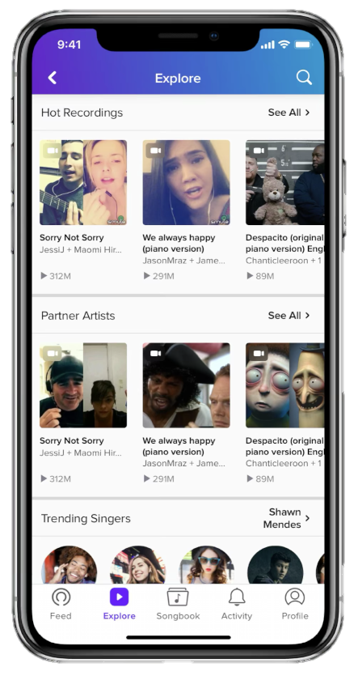
Will You Be My Smulemate?
Objective:
Create a recommendation system for other singers with similar singing styles.
Notes:
Build slide, Add problem statement/combine with objective

Slide 4
Methodology
Vocal
Audio
Source | Stanford Digital Archive of Mobile Performances (DAMP) Dataset
# Performances | 24,874
# Songs | 10
# Singers | 5,429
Clip Length | 6 seconds
Notes:
Bring in data and tools

Slide 5
Methodology
Vocal
Audio
MFCC
Mel-Frequency Cepstral Coefficient
Extracted 12 Features for 6 seconds of audio
12x216 matrix reshaped to 1x2592
Notes:
Bring in data and tools

Slide 6
Methodology
Vocal
Audio
MFCC
Normalize
Standard Scaler
0.0 to 1.0
Notes:
Bring in data and tools

Slide 7
Methodology
Vocal
Audio
Dimensionality
Reduction
MFCC
Normalize
Principle Component Analysis
2592 to 1000 components
Notes:
Bring in data and tools

Slide 8

`
Recommendations
Top 3 based on highest cosine similarity
User 398623803
Song: All of Me
Gender: F
Age: 28
Country: France
User 100562302
Song: All of Me
Gender: F
Age: 27
Country: US
User 746365434
Song: All of Me
Gender: F
Age: 29
Country: US
User 94852496
Song: All of Me
Gender: F
Age: 26
Country: Denmark
Notes:
Play best and worst

Slide 9
Singing Styles
Insert cluster graph here
K-Means Clustering
Clusters:
A
B
C
D
E
Notes:
Last priority

Slide 10
Conclusion
With singer recommendations a user may:
Explore singers with similar singing styles
Choose to collaborate with the singer
View other performances by the singer
Future Work
Create a recommendation system for different singing styles
Notes:
Combine with future work

Slide 11
CATHERINE MAGSINO
catherinekay@outlook.com
/in/catherinemagsino
Thank You!
Notes:
Add info about me

Slide 12
Appendix

